Slide 1

ReadersHaven
By Karina & Li

Slide 2
Requirements
Add Books with ‘title’ , ‘author’ and ‘price’
Retrieve the book inventory as a booklist
Filter Books by ‘author’

Slide 3
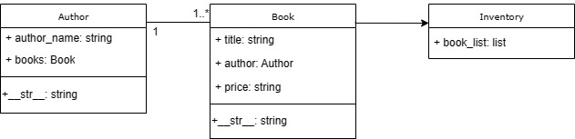
Class diagram

Slide 4
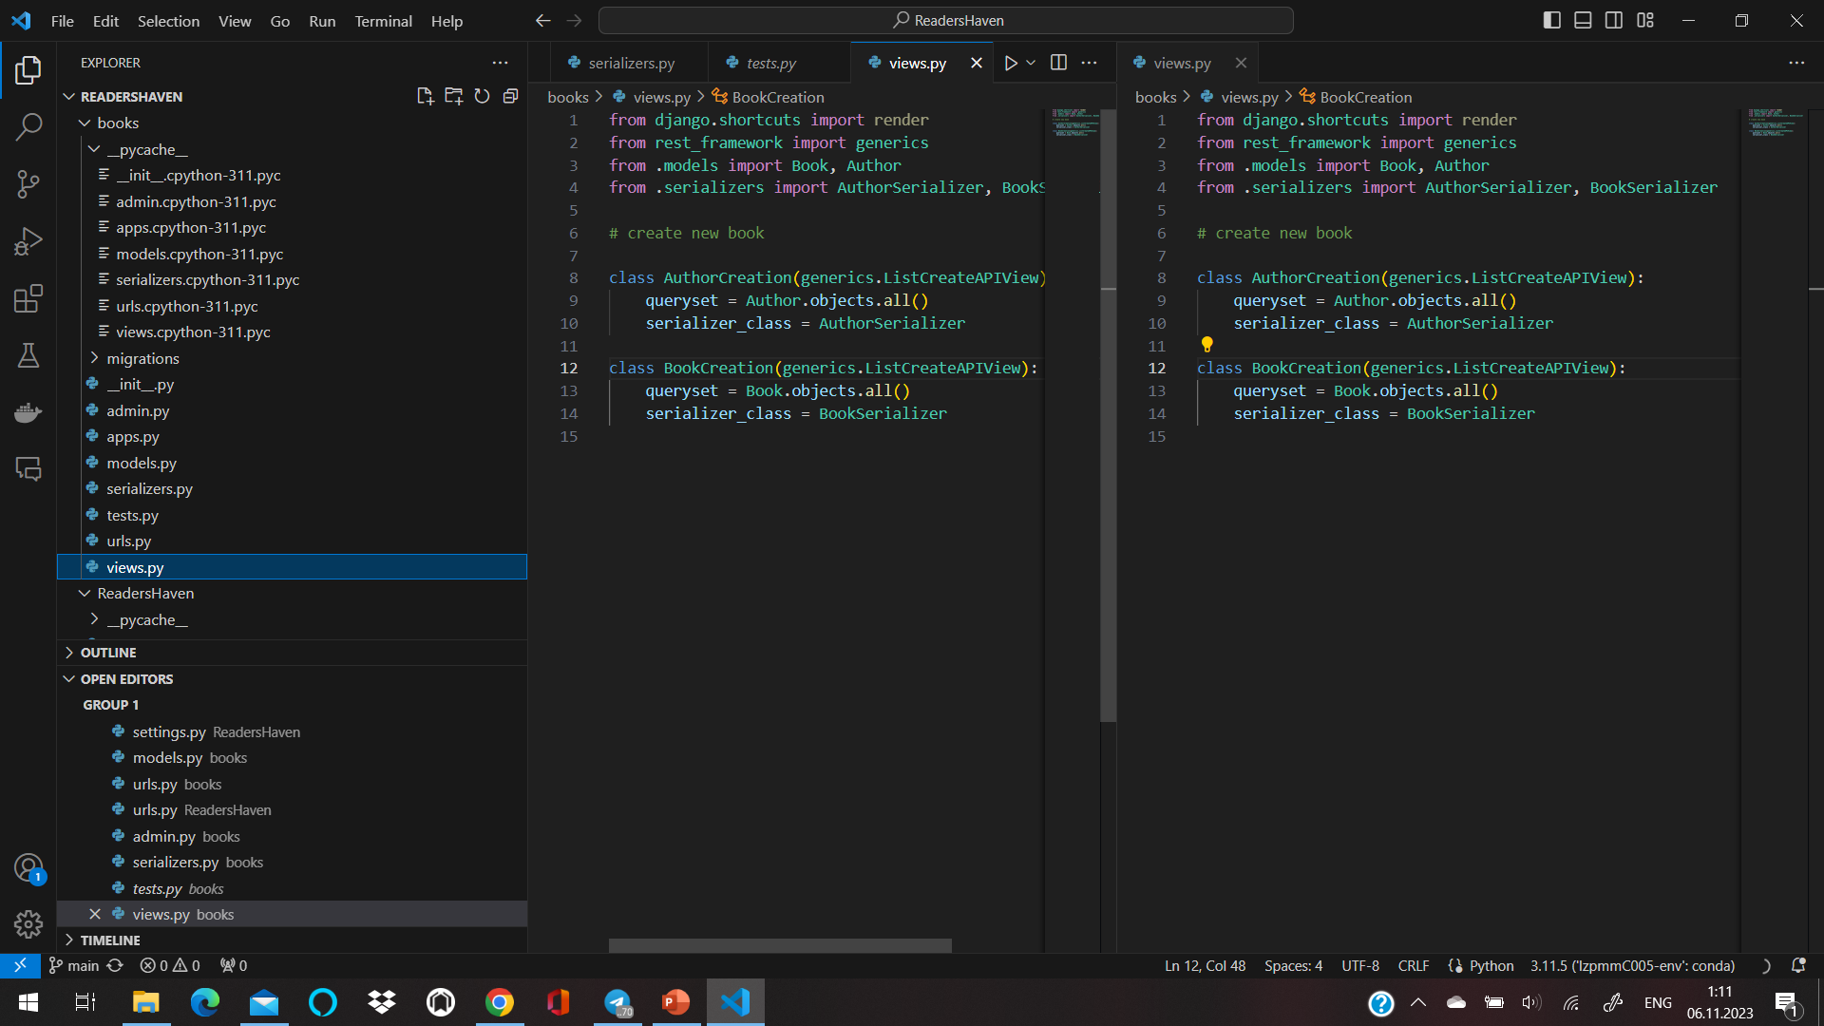
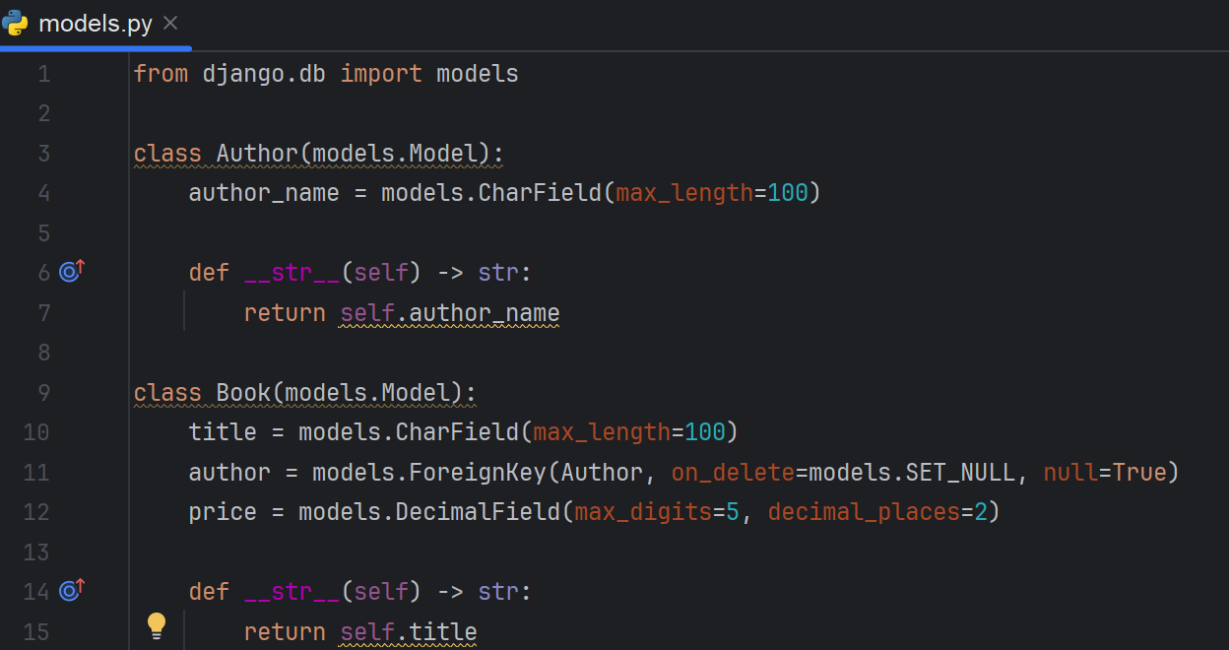
Django project "books" creation
"books" - django project (config folder was created automatically)
models.py {
Title
Price
Author
}

Slide 5
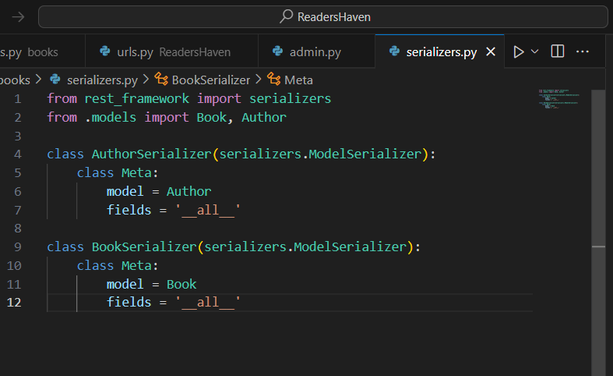
serializers
Serializers.py - changes view of output data

Slide 6
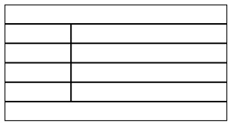
{…
Name =
Value =
...}

Slide 7
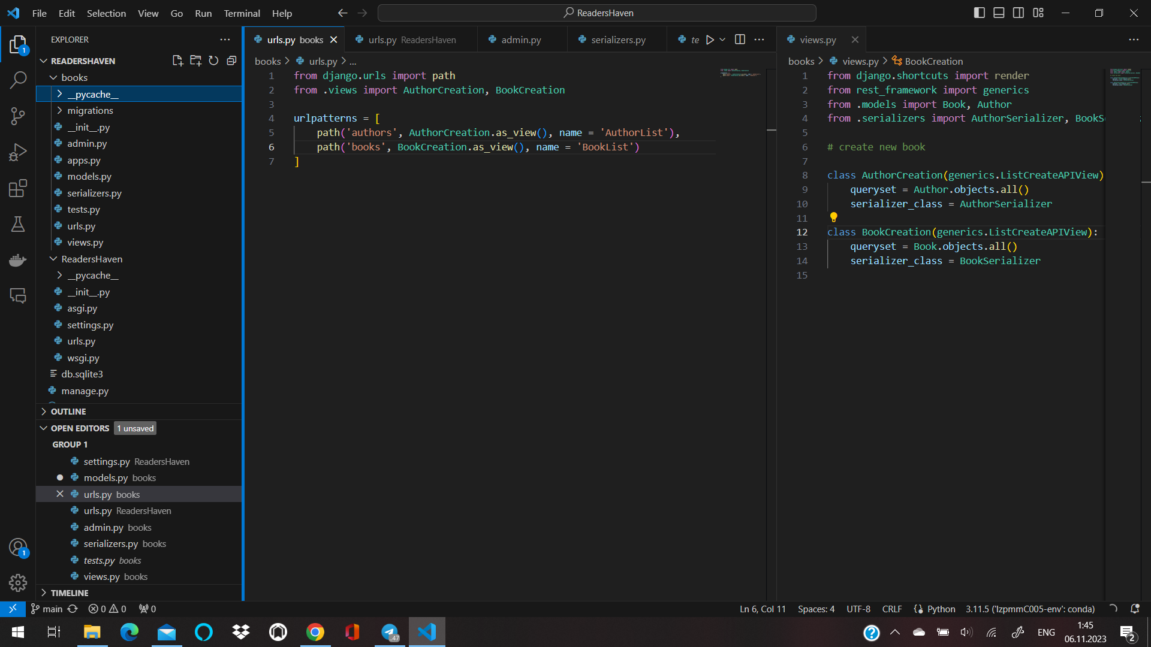
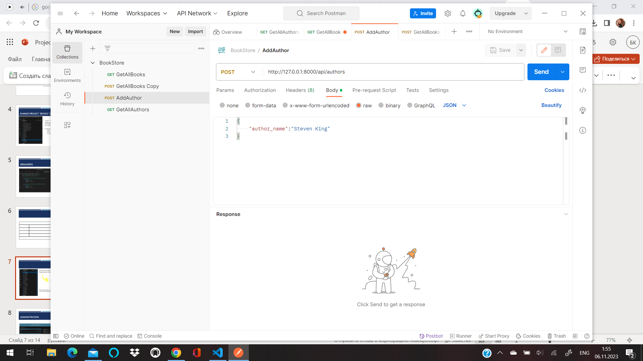



Connect books and ReadersHaven folders
Rest Framework for creation WEB API
Checking for the correct work with Postman
(add books to the list, return all inventory)

Slide 8
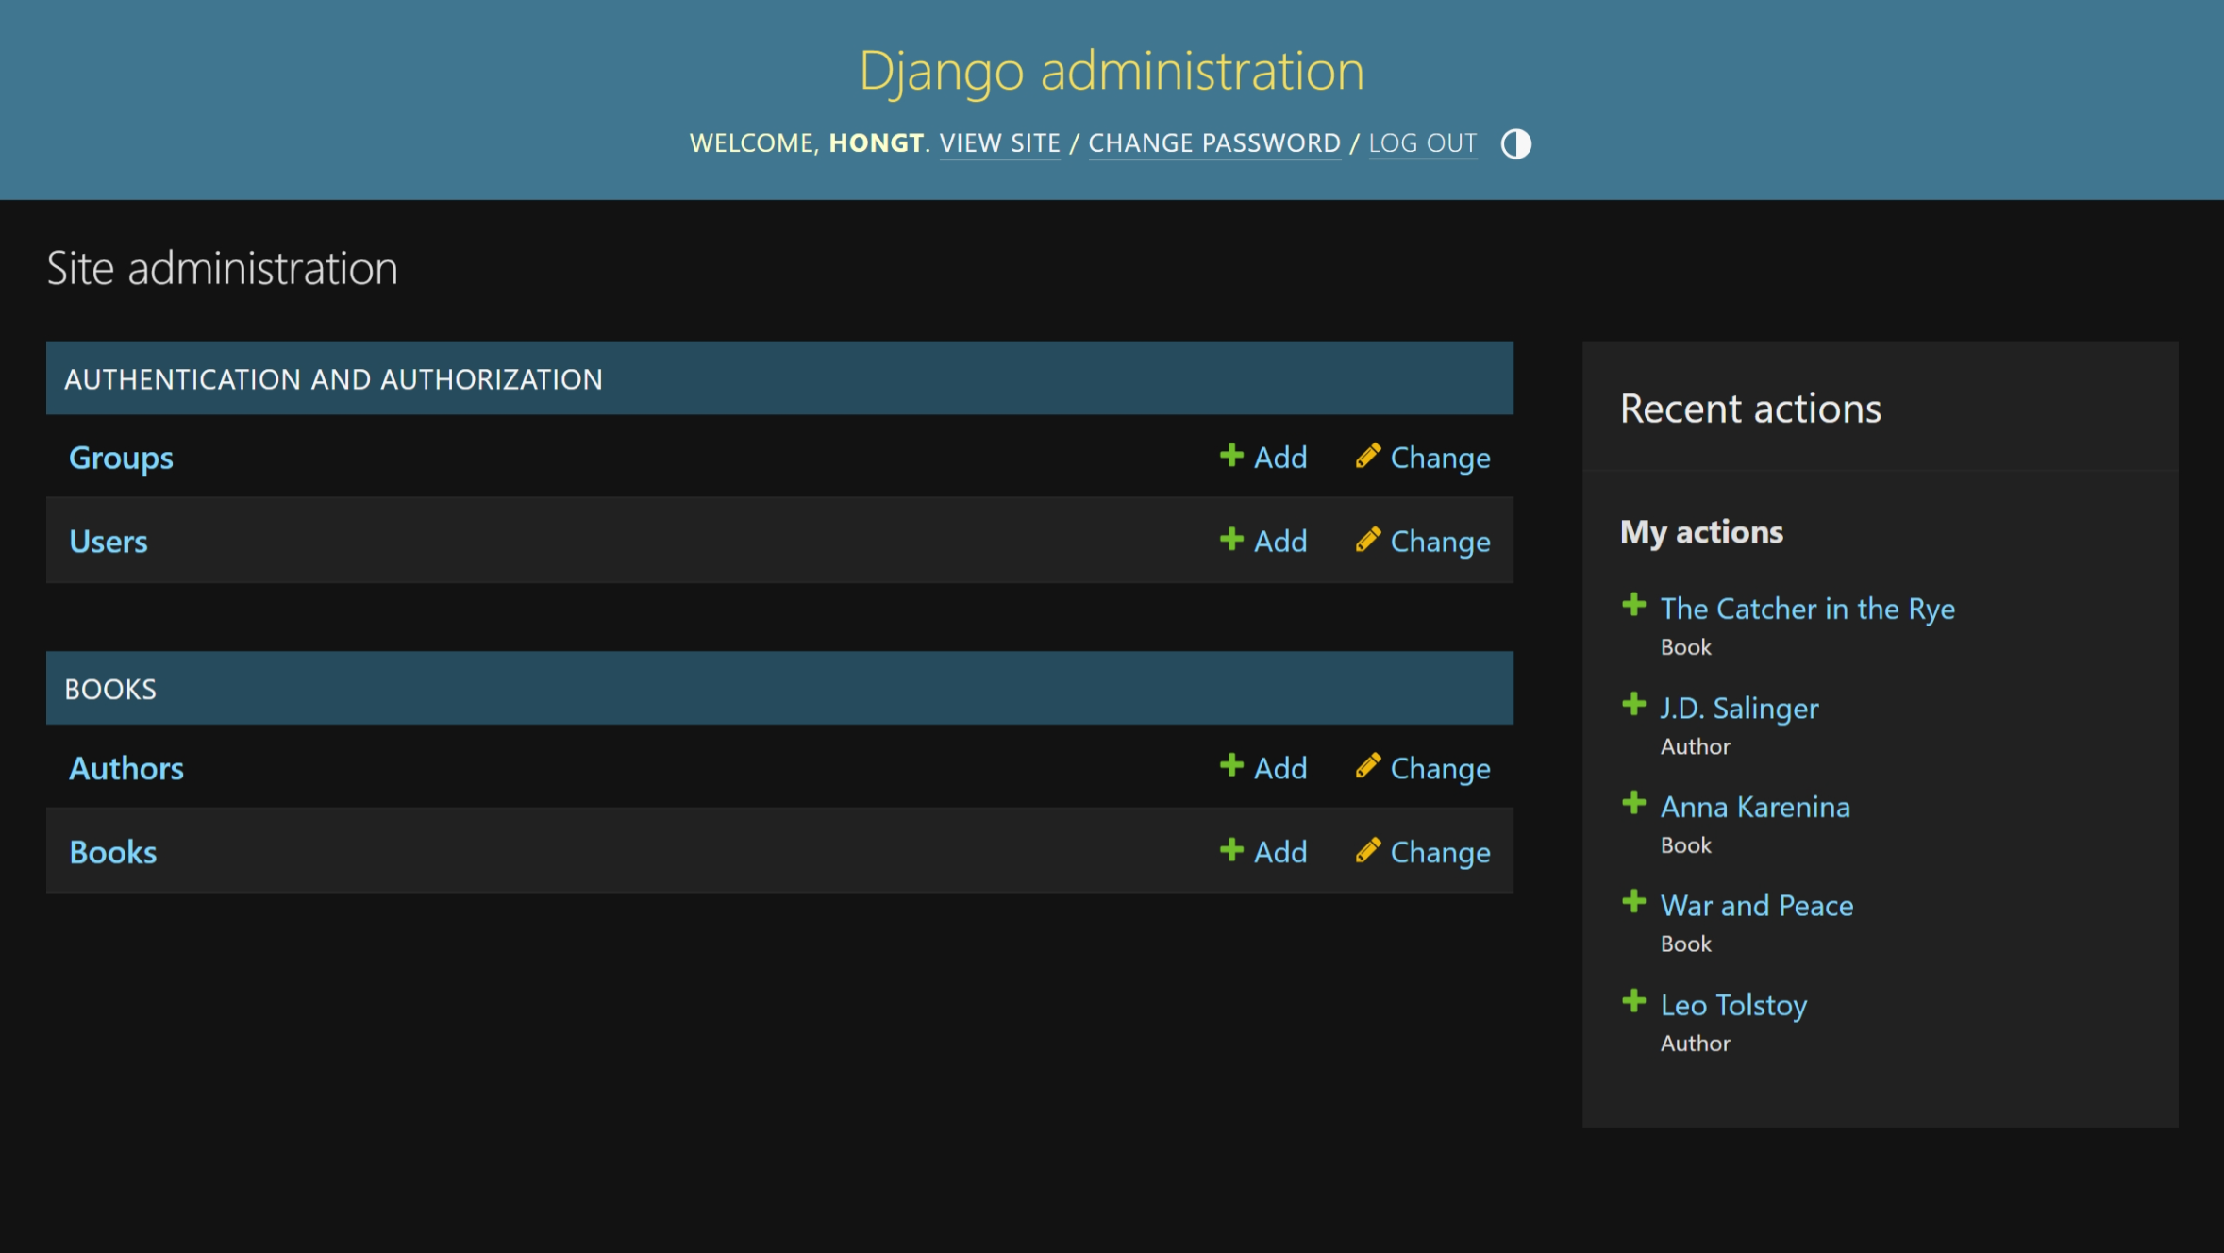
Administration
1. ReaderHaven/books/models.py
Define class Author and Book
2. ReaderHaven/book/admin.py
Register Author and Book by
class Author(models.Model): author_name = models.CharField(max_length=100) class Book(models.Model): title = models.CharField(max_length=100) author = models.ForeignKey(Author, on_delete=models.SET_NULL, null=True) price = models.DecimalField(max_digits=5, decimal_places=2)
admin.site.register()

Slide 9
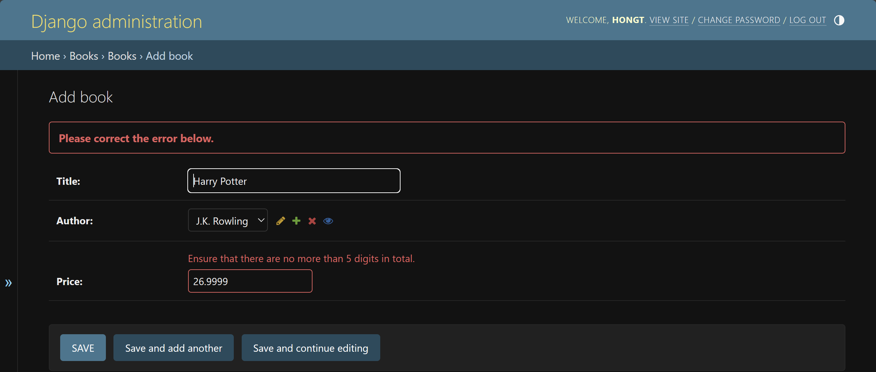
Add book
http://localhost:8000/admin/books/book/add/

Slide 10
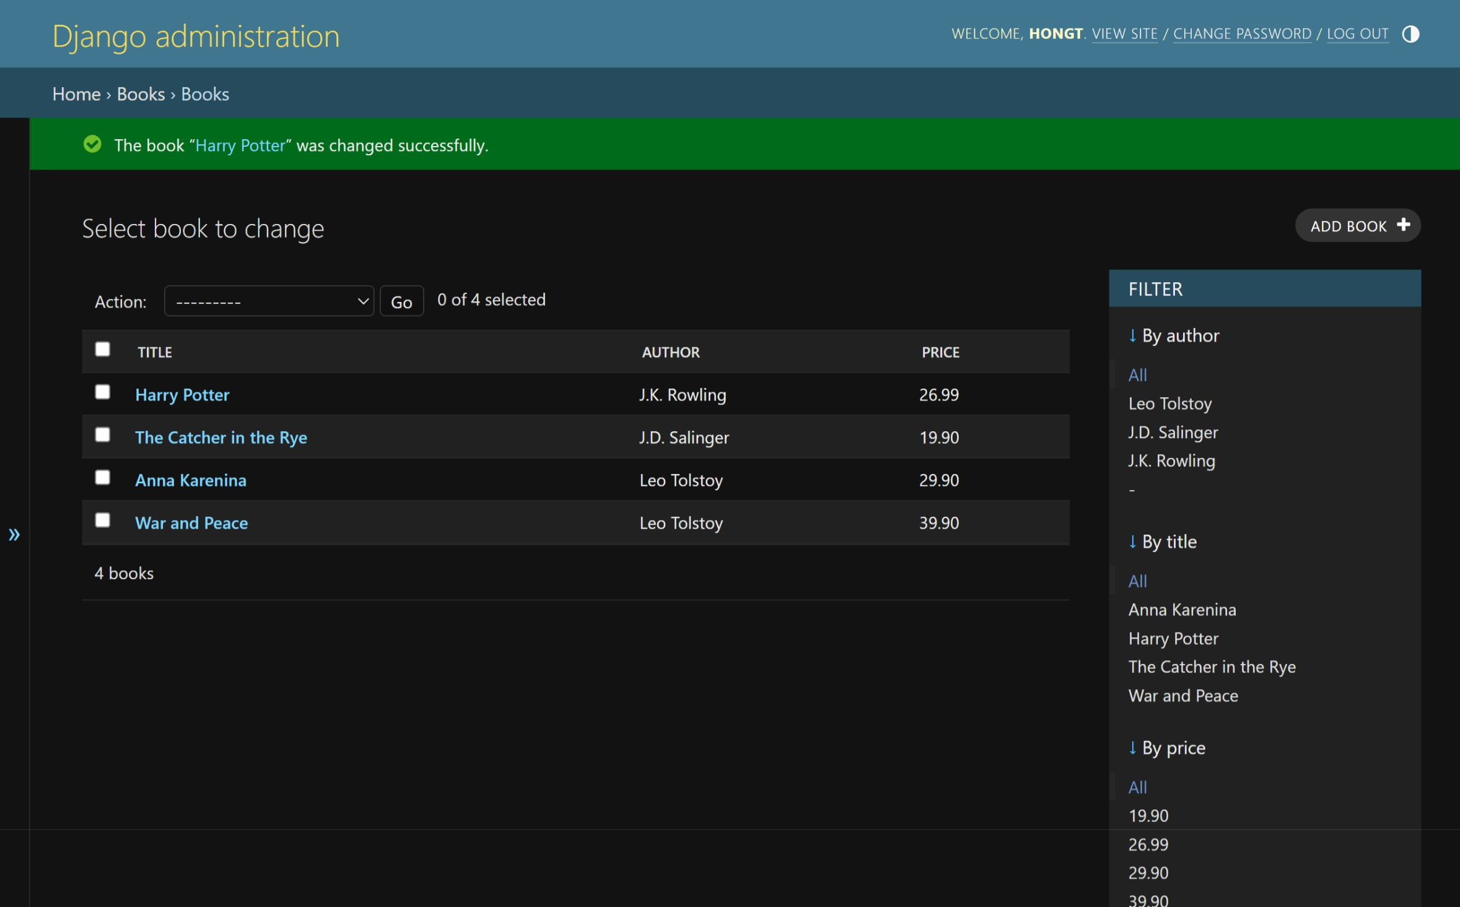
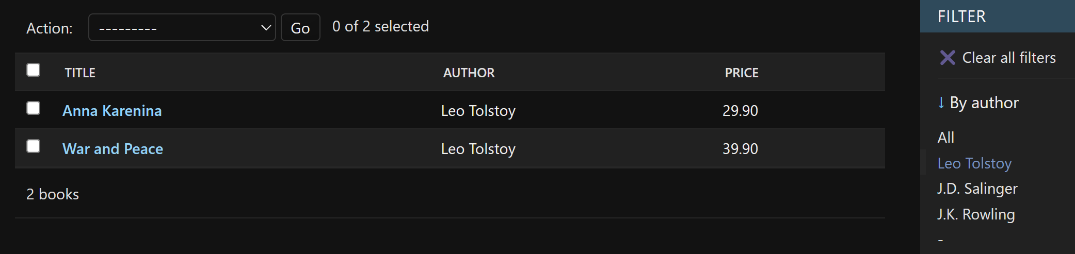
Books display and filter
class BookAdmin(admin.ModelAdmin): list_display = ('title', 'author', 'price') list_filter = ('author', 'title', 'price') admin.site.register(Book, BookAdmin)

Slide 11
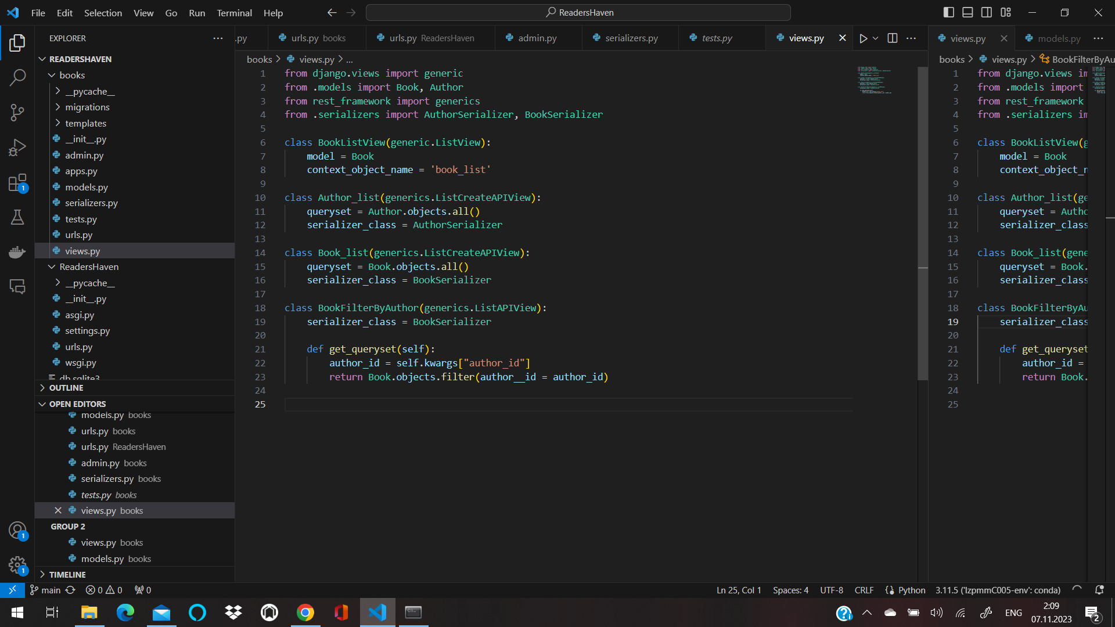
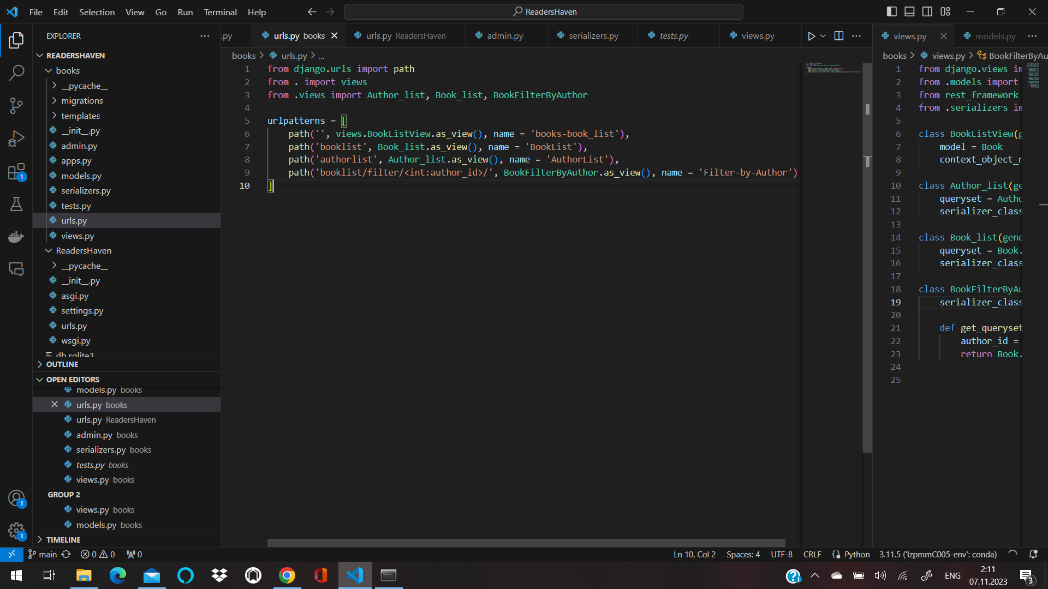
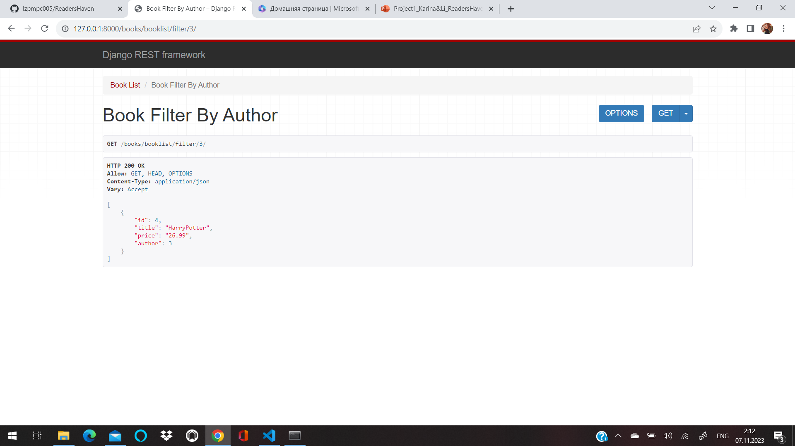

Slide 12
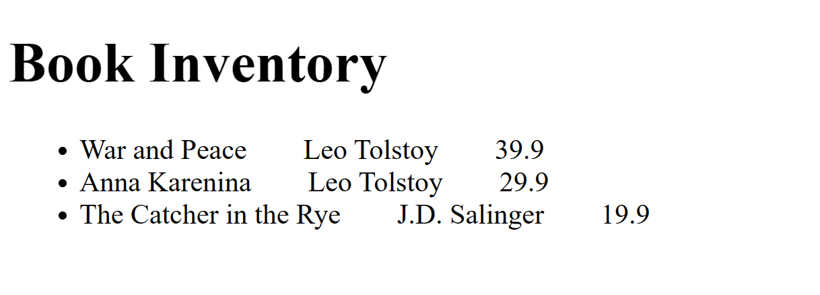
Book inventory
http://localhost:8000/books/
<body> {% block content %} <h1>Book Inventory</h1> {% if book_list %} <ul> {% for book in book_list %} <li> {{ book.title }}&emsp;&emsp;{{book.author}}&emsp;&emsp;{{book.price}}&emsp;&emsp; </li> {% endfor %} </ul> {% else %} <p>There is no book in the inventory.</p> {% endif %} {% endblock %} </body>
class BookListView(generic.ListView): model = Book context_object_name = 'book_list'

Slide 13
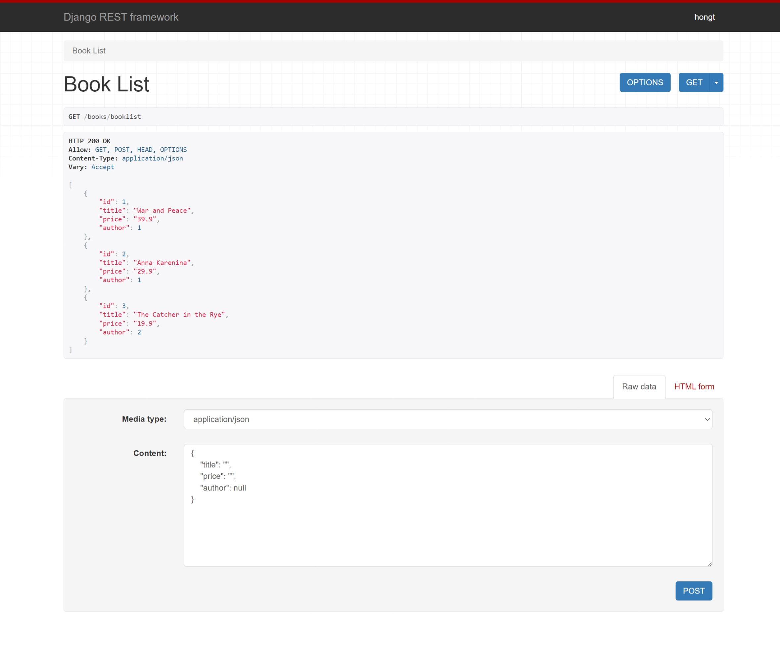
http://localhost:8000/books/booklist
class Book_list(generics.ListCreateAPIView): queryset = Book.objects.all() serializer_class = BookSerializer

Slide 14
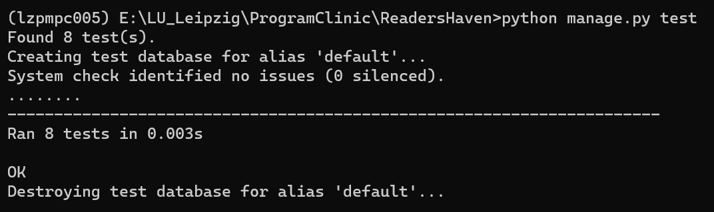
Tests
from django.test import TestCase from .models import Author, Book class AuthorModeTest(TestCase): @classmethod def setUpTestData(cls): Author.objects.create(author_name='Leo Tolstoy') def test_author_label(self): author = Author.objects.get(id=1) field_label = author._meta.get_field("author_name").verbose_name self.assertEqual(field_label, "author name") class BookModelTest(TestCase): @classmethod def setUpTestData(cls): Author.objects.create(author_name='Leo Tolstoy') Book.objects.create(title='War and Peace', author=Author.objects.get(), price='39.9') def test_title_label(self): book = Book.objects.get(id=1) field_label = book._meta.get_field('title').verbose_name self.assertEqual(field_label, 'title')

Slide 15
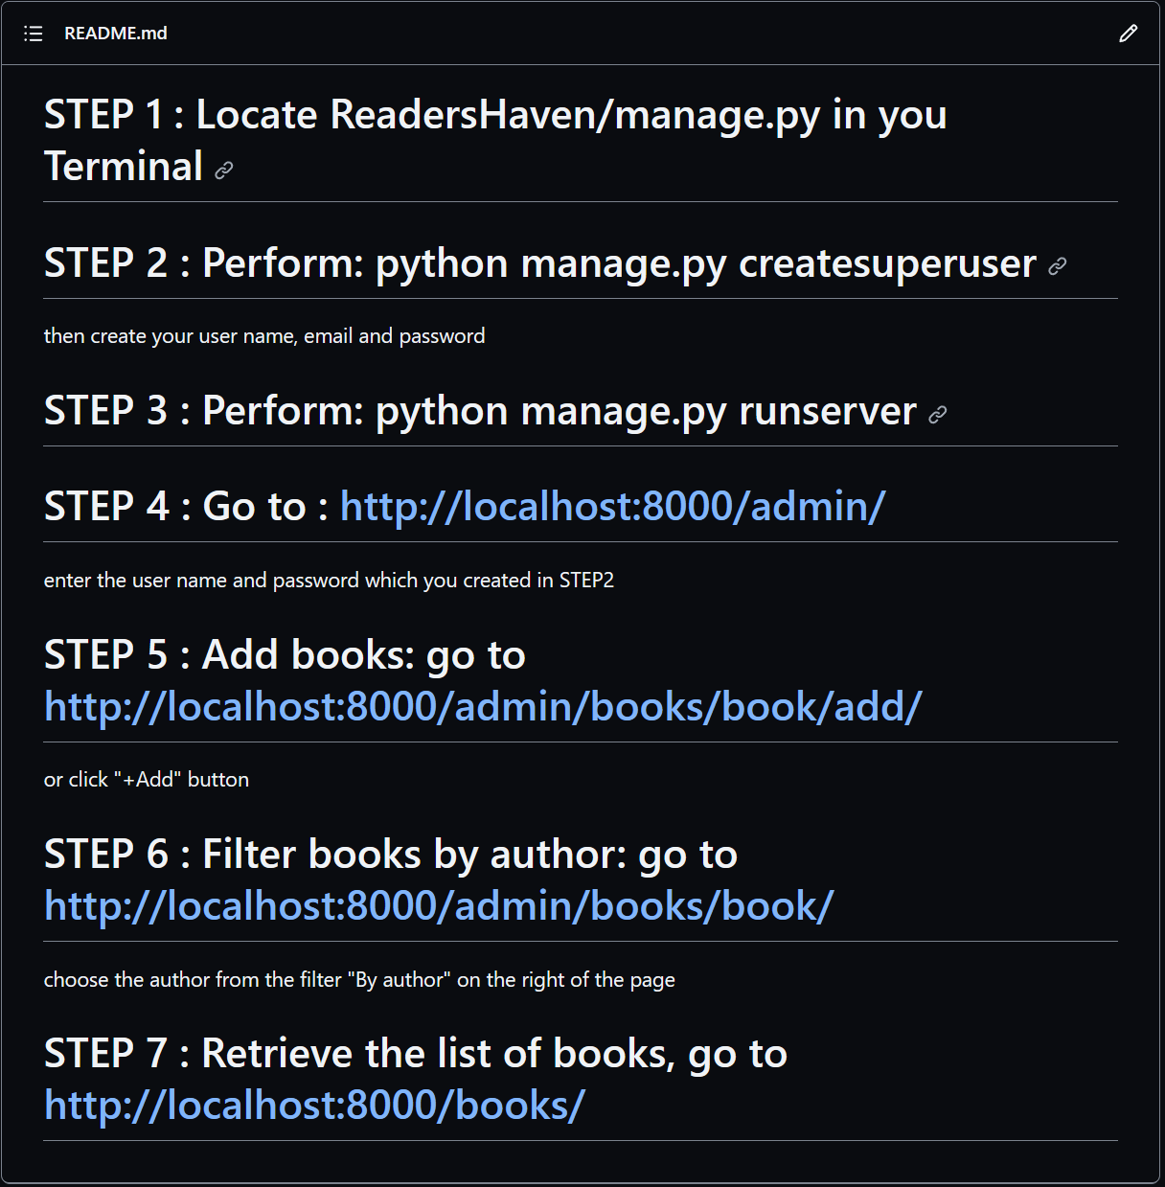
Readme

